Slide 1
Final Presentation
Maham Khalid & John Lopez-Delgado
(Equal Participation)

Slide 2
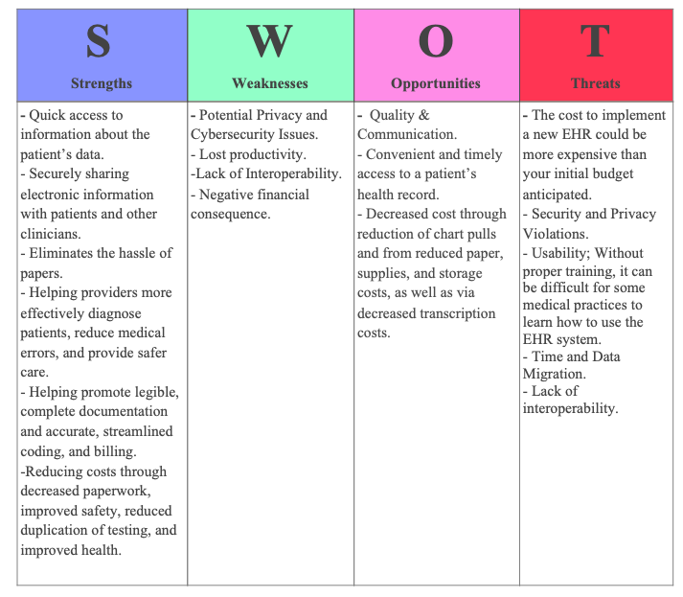
Feasibility Analysis
SWOT Analysis
SWOT analysis helps identify strengths, weaknesses, threats, and opportunities of an organization. SWOT analysis can help you in creating a business plan. It helps determine your intended goal and tactics to implement in the future in order to maintain the current level of performance. It also us helped answer questions for our project - which areas are you most successful in? What areas do you think could use the most improvement? What future events could be beneficial to your business performance? What competitors might you face in the near future? What threats do you think you'll be up against in the near future?

Slide 3
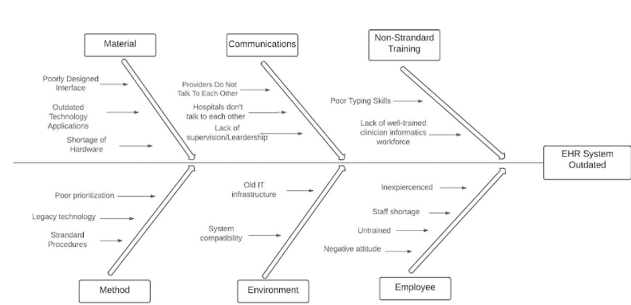
Feasibility Analysis
Preliminary Investigation Analysis
(Fishbone Model)
The preliminary investigation's aim is to see whether a problem or weakness in the existing system still exists.The end result is a recommendation on whether or not to continue with the project.The fishbone diagram helped determine the source of a problem. Instead of concentrating on the obvious cause of an issue, the fishbone diagram considers all possible causes and combines them to find the root of variation. It determines ways to improve the process. Something that we would like to learn more about the fishbone are the Disbadvatges and is it still used currently?

Slide 4
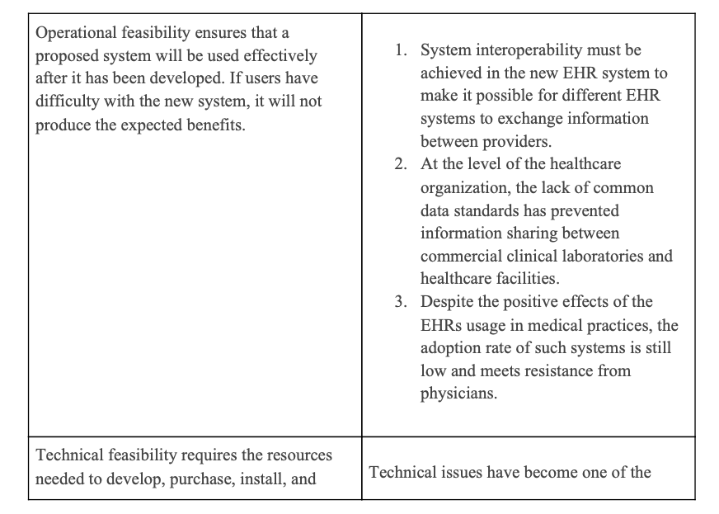
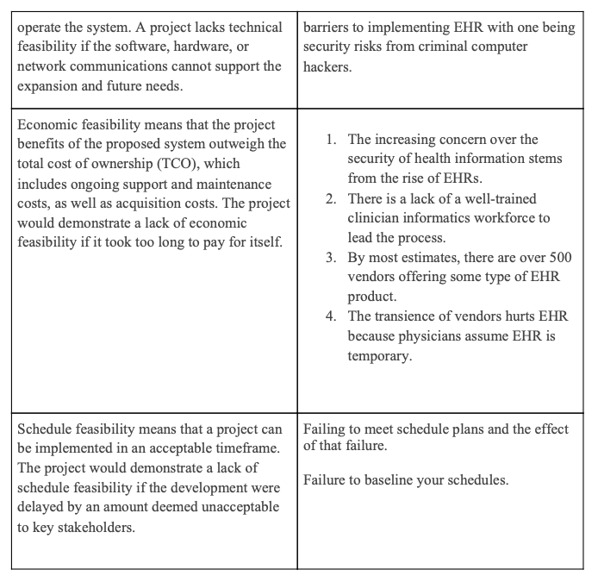
Feasibility Analysis
Feasibility Grid
We learned about the four types of feasibility which are Technical feasibility, Schedule feasibility, Economic feasibility, and Operational feasibility. Technical feasibility helped determine the project technically feasible at the time. What is the technical risk? The technology's usability. Is it going to work for others? etc. Schedule feasibility helped determine if it is possible to create a solution that would be useful in a reasonable amount of time? Are there any time constraints? Economic helped determine projects costs of production and operation. Do the advantages outweigh the costs? Operational feasibility helped determine projects hardware for system maintenance (repairs, lease, supplies) software (licensing and contracts).

Slide 5
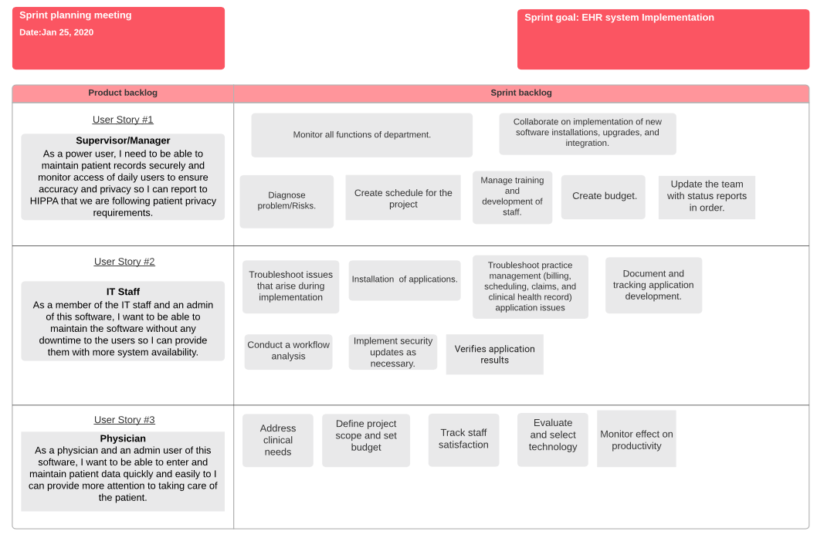
Project Plan
Sprint Plan
Sprint plan helped determine the tasks that each user is assigned to do. Sprint planning involves everyone on the team. Tasks are assigned amongst the team members based on their experience levels and expertise. These entries are updated and broken into smaller stories by the team so that they can be completed.

Slide 6
Systems Requirements Checklist
Input Requirements:
-Configure the software
-Identify hardware needs
-Install the production solution.
-Migration of data.
-Perform final verification in production.
-Implement new processes and procedures. -Monitor the solution.
Output Requirements:
-Complete and accurate information.
-Patients receive better medical care.
-Improves the ability to diagnose diseases and reduce and prevent medical errors, improving patient outcomes.
-Improving aggregation, analysis, and communication of patient information.
-Improved quality of care screenings in Breast Cancer, Diabetes, Chlamydia, Colorectal Cancer and much more.
Process Requirements:
-The system must be available and reliable 24/7.
-The hospitals must share data electronically with labs, radiology, providers, and public health registered.
-The system must maintain HIPPA requirements so that they to show the audit of patient records, including who has access and what data they have access to.
Control Requirements:
-HIPPA for securing protected information. -An audit trail (how long, and who logs of to electronic health records)
-Password protection. -Data Encryption. -Installing and regularly updating antivirus and anti-malware software.
-Making backup copies of important data and information.
Requirements Models
Input Requirements helped determine what we need to enter into the system. Output Requirements helped us detaine what we want want to produce or the results from the system. Process Requirements helped determine what specific tasks, work, does our system accomplish. Control Requirements helped determine what types of security or control should our system provide.

Slide 7
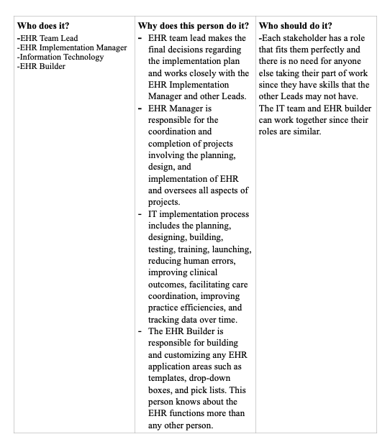
Requirements Models
Current vs Proposed System

Slide 8
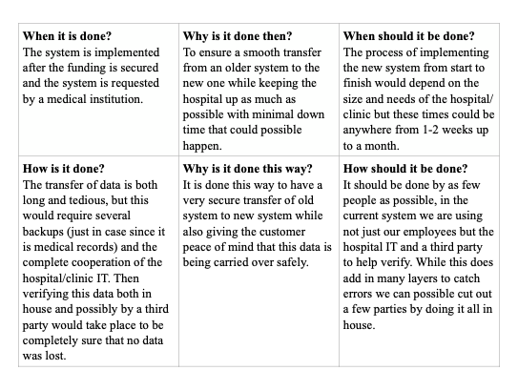
Requirements Models
Current vs Proposed System
Current vs Proposed system helped us compare information about the existing project and what we will be doing with the project and how we are going to do it. We use fact-finding techniques, such as interviews, surveys, observations, and sampling, to describe the current system and identify the requirements for the new system.

Slide 9
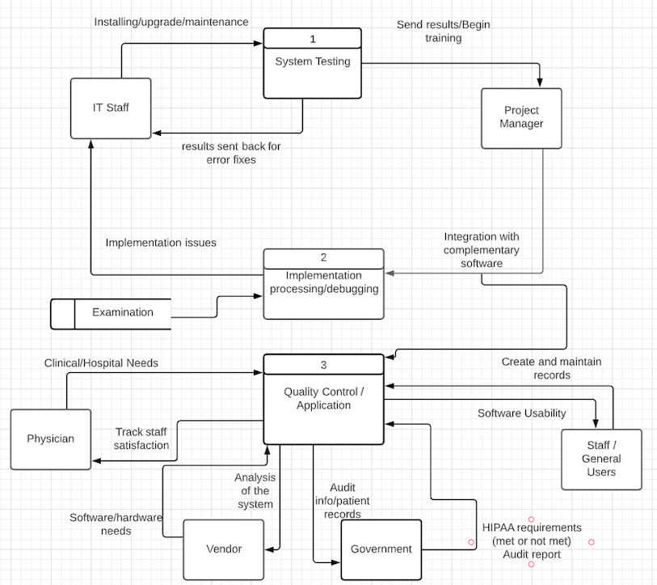
Data Flow Diagram
Data Flow Diagrams are a visual representation for the flow of data across a system. Three major components in a DFD are entity, database, and process. It helps us in understanding the system's logic and concept, as well as its performance process. Creating the DFD helped resolve any problems with the project. We can check to see if any important inputs, processes, or decisions have been missed. Something that we would like to learn more about are the limitations/disadvantages of DFDs.

Slide 10
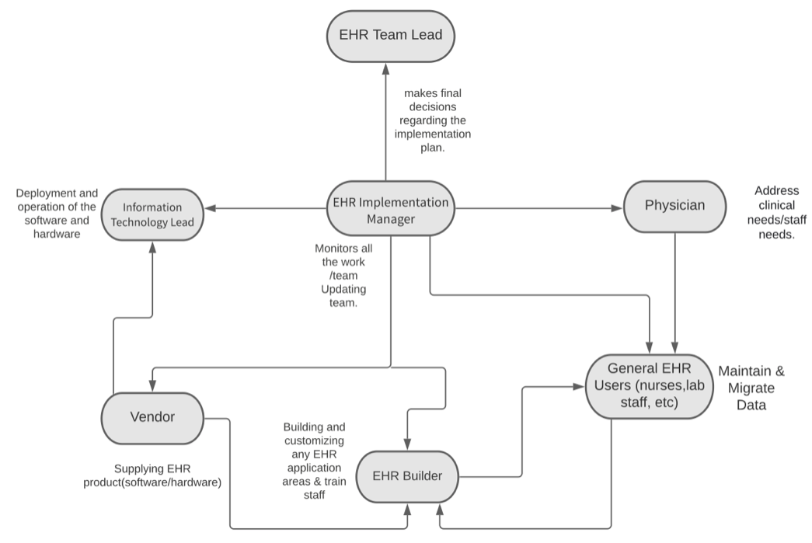
UML/Object Models
Object Relationship Diagram
Entity Relationship Diagrams represent the relationships between groups of data or information and how they interconnect. The relationships are easy to understand, It offers a straightforward breakdown for those looking for a quick description of the database's layout.

Slide 11
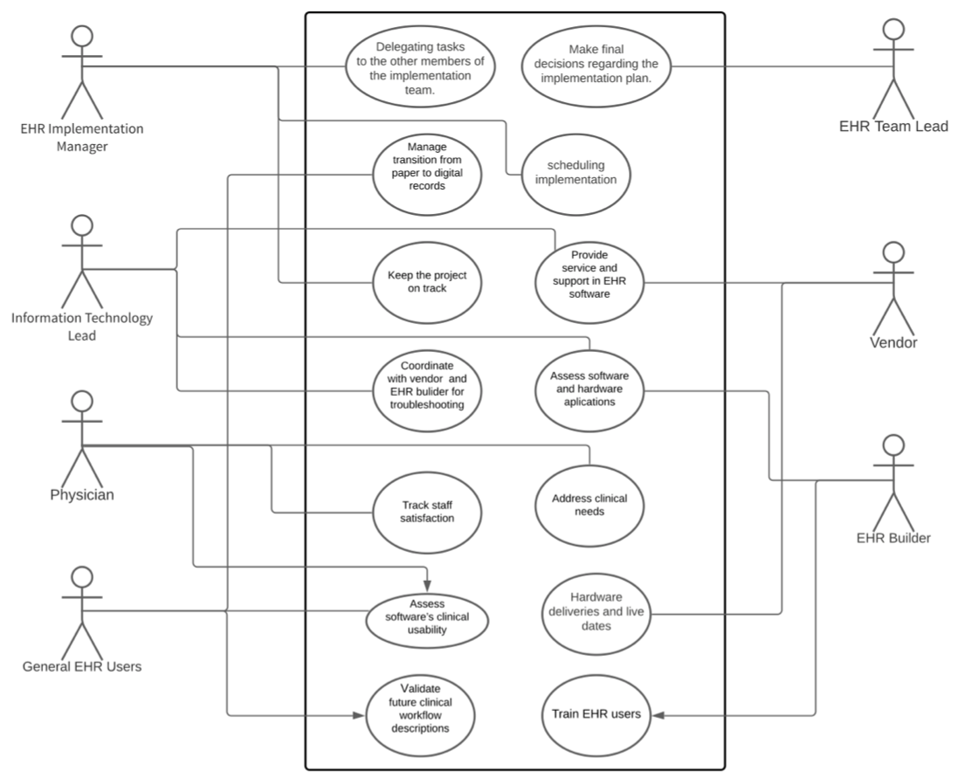
UML/Object Models
Use Case Diagram
A use case diagram is a visual representation of how a user could interact with a system. It should help your team define and organize requirements. This diagram contains three components: actors, system, and goals. They can also describe methods in which actors collaborate to achieve a goal. Something the we would like to learn is in which situations should we not use this diagram?

Slide 12
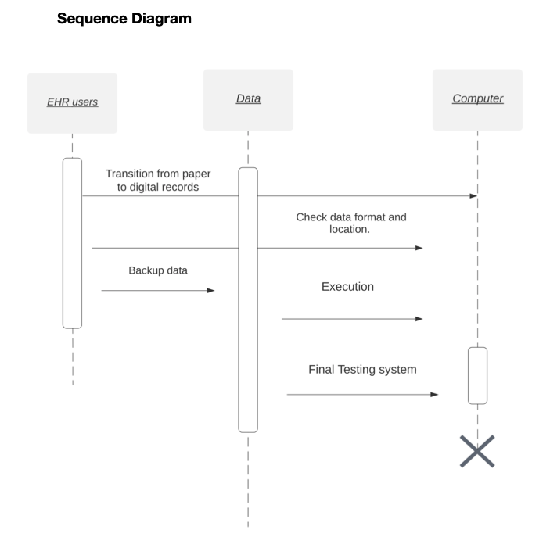
UML/Object Models
Sequence Diagram
Sequence diagrams specifically focus on lifelines, or the processes and the messages exchanged between them in order to execute a function before the lifeline is terminated. In a sequence diagram, different types of messages and operators are used. Lifelines in the system take part during the execution of a system. Sequence diagrams are easier to maintain and manage.

Slide 13
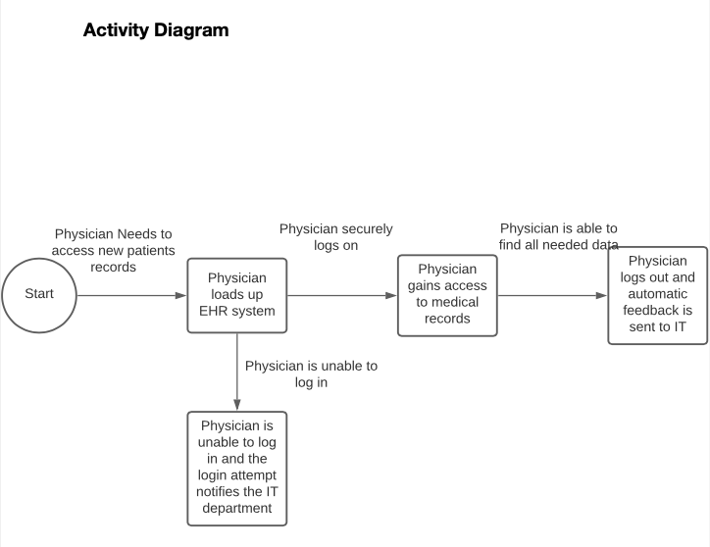
UML/Object Models
An activity diagram is a flowchart that represents the flow of information from one activity to the next. People on the business and development sides of a company will use activity graphs to understand the same system and actions. I thought us how to describe the steps performed in a UML use case. It simplified and improves any process by clarifying complicated use cases.

Slide 14
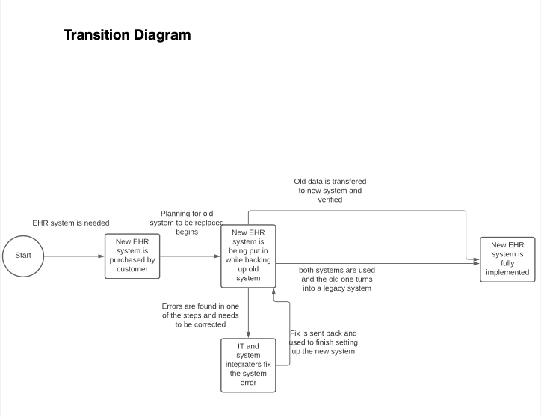
UML/Object Models
State
State-Transition Diagrams thought us all of the possible states for an entity, as well as the circumstances that cause it to change state, the conditions that must be met before the transition can take place, and the actions that occur over its lifetime. State diagrams are a powerful method for explaining processes and their potential outcomes. State diagrams can be found in a variety of contexts and are simple to understand.

Slide 15
Key Concepts
Requirements Modelling which involves using fact-finding techniques, such as interviews, surveys, observations, and sampling, to describe the current system and identify the requirements for the new system such as outputs. inputs, processes, performance, and control.
Logical data flow diagrams focuses on what happenes in a particular information flow, what entities are receiving information etc.
Physical data flow diagrams focuses on how things happen in an information flow. These diagrams specify the software, hardware, files, etc.

